Slide 1
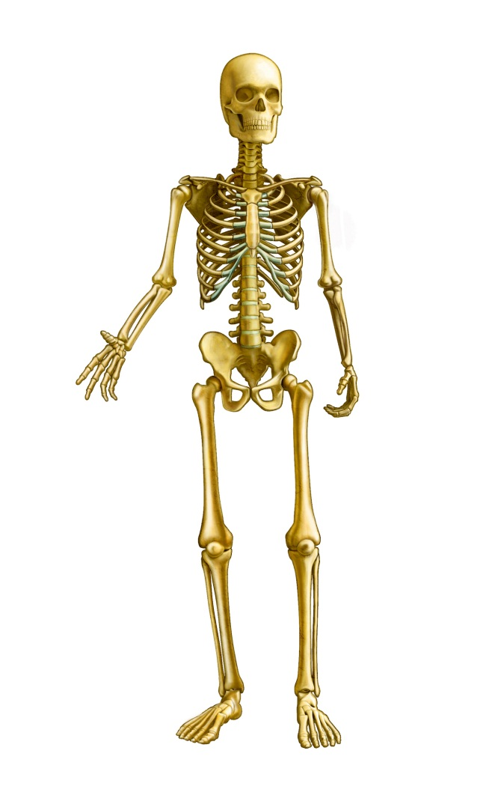
Skeletal System
Diseases and Disorders

Slide 2
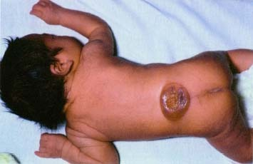
Spina Bifida
The spinal cord does not form properly and as a result the vertebrae and skin can not form around it.

Slide 3
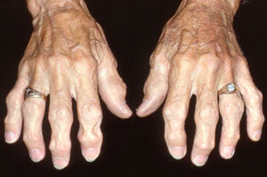
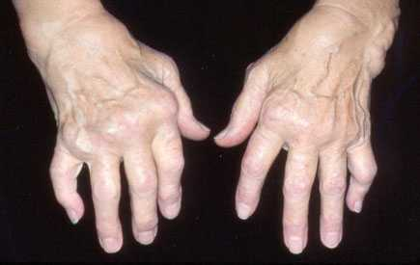
Osteoarthritis
Cartilage around the joints wears down and as a result joints become swollen tender and stiff.

Slide 4
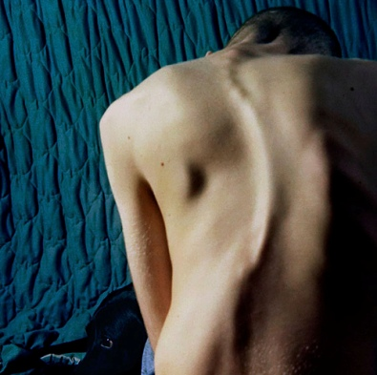
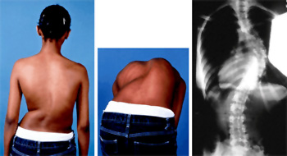
Scoloiosis
Side to side curvature of the spine.

Slide 5
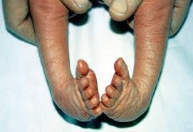
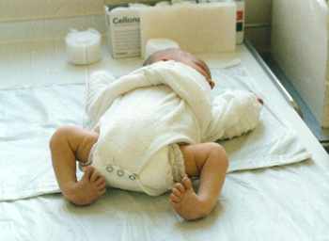
Talipes equinovarus
Also known as Club foot. The bones of the foot are bent down and inwards.

Slide 6
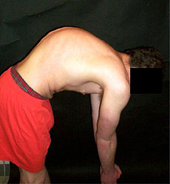
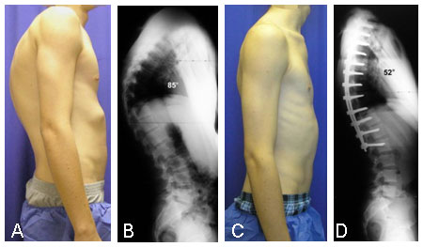
Kyphosis
Hunchback – bones of the upper vertebrae curve inward as a result of rheumatoid arthritis, tuberculosis or syphilis.
Kyphosis Normal

Slide 7
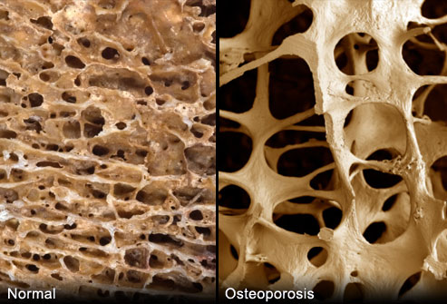
Osteoporosis
Loss of bone tissue as a result of lack of Calcium.

Slide 8
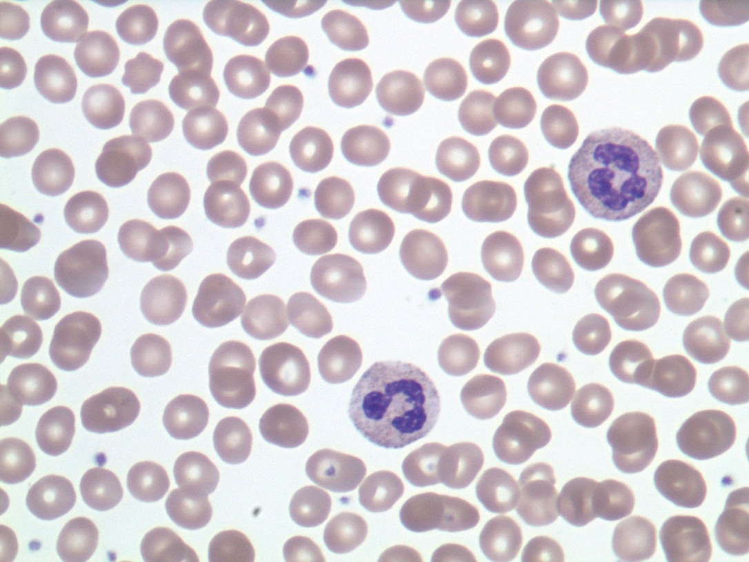
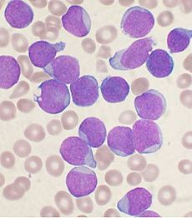
Leukemia
White blood cells, which are produced by marrow, multiply out of control.
Normal blood Leukemia blood

Slide 9
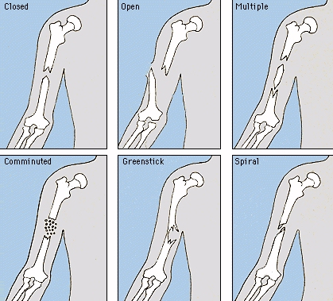
Fractures

Slide 10
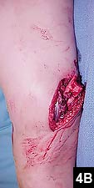
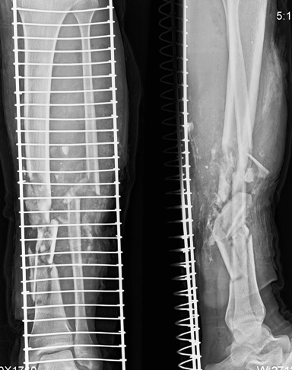
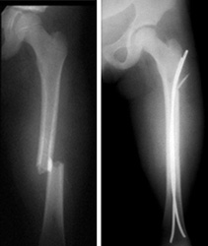
Fractures

